Slide 1
Lecture 22
The Holistic Perception of Harmony in Existence

Slide 2
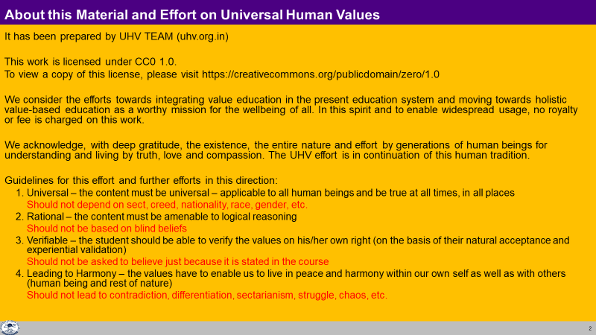

Slide 3
Harmony in Existence vfLrRo esa O;oLFkk
Existence vfLrRo =
Units Submerged in Space Ever Present
bdkb;ka lai`Dr “kwU;
Limited in Size lhfer vkdkj Unlimited vlhe
(All Pervading, O;kid)
Activity, Active fØ;k] fØ;k'khy No Activity fØ;k”kwU; ¼“kwU;½
  1. Energised in Space (“kwU; ds lg&vfLrRo esa ÅftZr gS)
  2. Self organised in Space (“kwU; ds lg&vfLrRo esa fu;af=r gS] Lo;a esa O;oLFkk gS)
  3. Recognises it's relationship,
  Fulfills its relationship with every other Unit in Space
  (“kwU; ds lg&vfLrRo esa ijLijrk dks igpkurh gS] fuokZg djrh gS
  cMh O;oLFkk esa Hkkxhnkj gS] lexz O;oLFkk esa Hkkxhnkj gS)
CO-EXISTENCE
lg&vfLrRo

Slide 4
Existence
(= Co-existence = Units submerged in Space)
Units (Nature)
Space (All-pervading)
Limited in size
Unlimited
This is already in harmony
Activity
No activity
Self-organized
Energized
Recognises the relationship and fulfills
Material tM+
Consciousness (Self) pSrU;
Temporary
Continuous
Recognising, Fulfilling
Knowing, Assuming, Recognising, Fulfilling
Physical Order
Bio Order
+
Animal Order
Atom
Cell
Only this part is remaining
And it has to happen in the Self by the Self
+
Molecule
Plant
Human Order
Molecular Structure
Animal Body
Right Understanding &
Right Feeling
Development
Linear – Not Cyclic
Lump
Fluid
Human Body
No Development
Cyclic
Definite Human Conduct
uf”pr Ekkuoh; vkpj.k

Slide 5
Now we can see that…
Happiness is an indicator, a feedback, that we
have understood harmony and
live in harmony
Unhappiness is an indicator, a feedback, that we
have not understood harmony and
do not live in harmony
Our role is to make the effort for excellence
to understand harmony and
to live in harmony
Continuous happiness
This is our role in existence …
at all 4 levels of our being
at one or more of the 4 levels of our being
at all levels of our being
  In the Self, as an Individual
  In Family
  In Society
  In Nature/Existence

Slide 6
Program for Human Being (Our Role in Existence)
Existence is Co-existence
Human Being is by virtue of Co-existence; embedded in Co-existence
All the Human Being needs to do is
  To understand Co-existence and
  To live in Co-existence

Slide 7
Program for Human Being (Human Role in Existence)
Human beings have two important things to do:
1. To understand the co-existence
  1.1. To understand co-existence – Knowledge (ज्ञान)
  1.2. To ensure the feeling, thought of co-existence – Resolution (समाधान)
2. To live in co-existence
  2.1. To live in co-existence with human-beings
  –family to world family – Undivided Society (अखंड समाज)
  2.2. To live in co-existence in nature
  –family order to world family order – Universal Human Order (सार्वभौम व्यवस्था)
  By these two being ensured by human beings, the result will be Undivided Society and Universal Human Order on Earth, in which Harmony and peace are very natural outcomes
  (and there is every provision in Existence for it)

Slide 8
Deluded Self: Imagination on basis of Sensation & Preconditioning
Self verification on the basis of Natural Acceptance
lgt Loh—fr ds vkËkkj ij tkap dj
 | Power “kfDr | Dynamic Activity xfr fØz;k | State Activity fLFkfr fØz;k
1. |  | Authentication Áek.k | Realization vuqHko
2. |  | Determination ladYi | Understanding cks/k
3. | Desire bPNk | Imaging fp=.k | Contemplation fparu
4. | Thought fopkj | Analysing fo'ys"k.k | Comparing rqyu
5. | Expectation vk'kk | Selecting p;u | Tasting vkLoknu
B1
3
Self (I)
eSa
Preconditioning
ekU;rk
1
B2
Body 'kjhj
2
Sensation
Lakosnuk
Behaviour O;ogkj
Human ekuo
Work dk;Z
Rest of Nature
euq";srj iz—fr
Other nwljk

Slide 9
Pure Self: Imagination on basis of Realisation, Understanding & Contemplation
Space “kwU;
 | Power “kfDr | Dynamic Activity xfr fØz;k | State Activity fLFkfr fØz;k
1. |  | Authentication Áek.k | Realization vuqHko
2. |  | Determination ladYi | Understanding cks/k
3. | Desire bPNk | Imaging fp=.k | Contemplation fparu
4. | Thought fopkj | Analysing fo'ys"k.k | Comparing rqyu
5. | Expectation vk'kk | Selecting p;u | Tasting vkLoknu
B1
Self (I)
eSa
B2
Body 'kjhj
Behaviour O;ogkj
Human ekuo
Work dk;Z
Rest of Nature
euq";srj iz—fr
Participation Òkxhnkjh
in larger Order O;oLFkk esa
Other nwljk

Slide 10
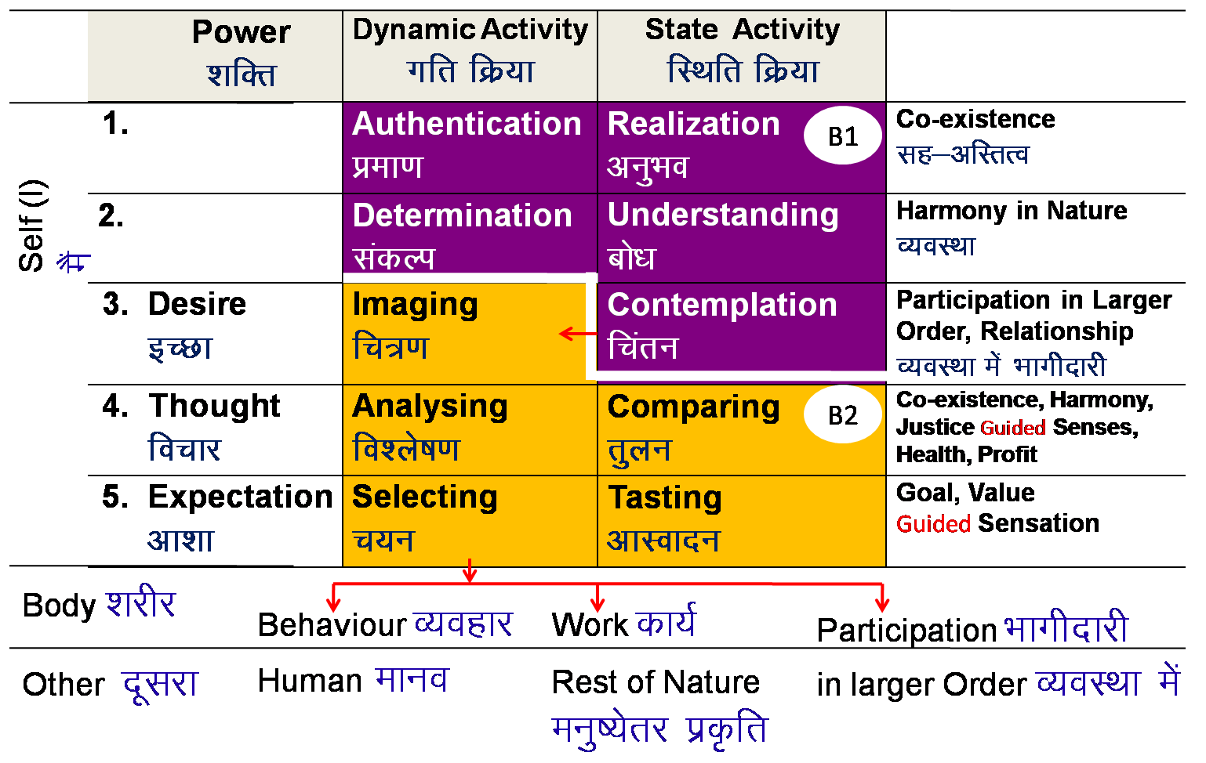
Realisation of Co-existence & it’s expression – Universal Human Order
REALISATION WITHIN
Mutual Happiness
mHk; lq[k
Mutual Prosperity
mHk; le`f)
Fulfillment of Human Goal
Ekkuo y{; dh iwfrZ
Human Tradition
ekuoh; ijaijk
Undivided Human Society
v[k.M ekuoh; lekt
EXPRESSION OUTSIDE
Universal Human Order
lkoZHkkSe ekuoh; O;oLFkk

Slide 11
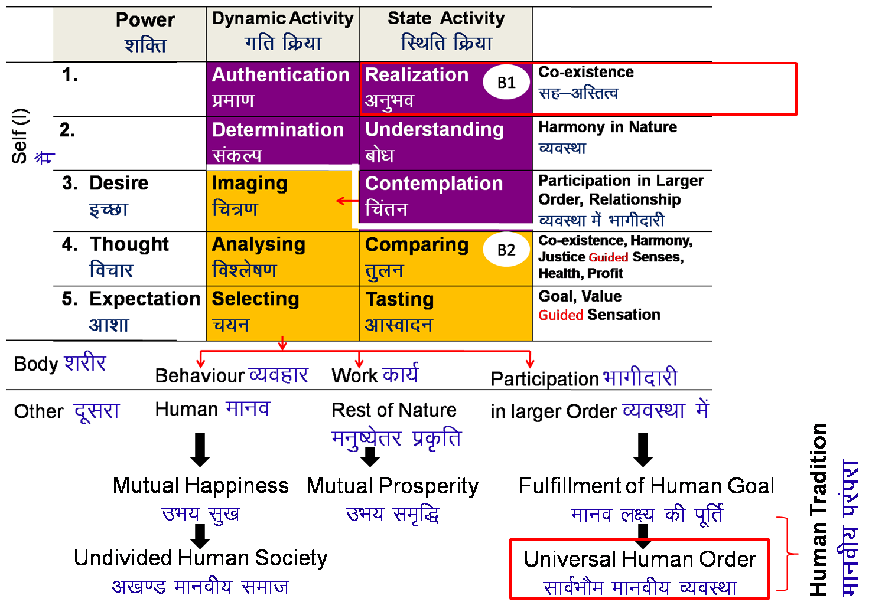
Existence
(= Co-existence = Units submerged in Space)
Universal Order
सार्वभौम व्यवस्था
Units (Nature)
Space (All-pervading)
Limited in size
Unlimited
Activity
No activity
Self-organized
Energized
Recognises the relationship and fulfills
Material tM+
Consciousness pSrU;
(Self)
Temporary
Continuous
+
Recognising, Fulfilling
Knowing, Assuming, Recognising, Fulfilling
+
+
Animal Order
Human Order
Physical Order
Bio Order
Atom
Cell
Molecule
Plant
Development
Linear – Not Cyclic
Molecular Structure
Animal Body
Lump
Fluid
Human Body
No Development
Cyclic

Slide 12
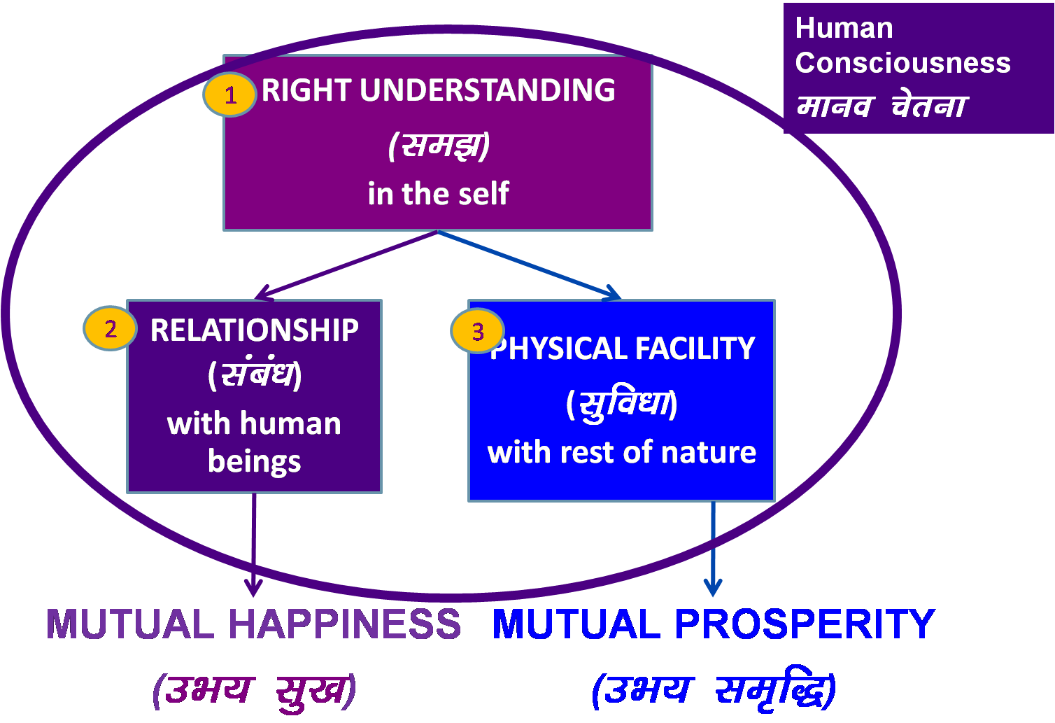
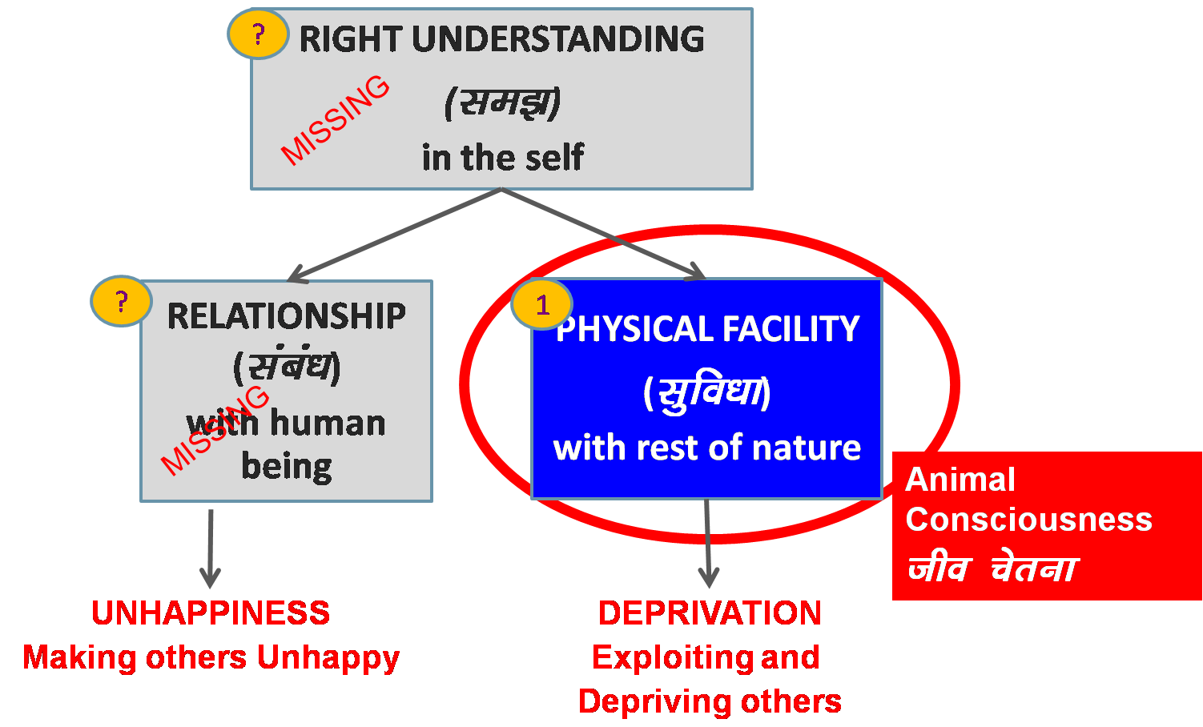
Holistic Development (fodkl) = Transformation (ladze.k)
Transformation& Progress
laØe.k&fodkl
Physical facility alone can’t ensure transformation, regardless of the extent of its increase
Holistic Development is ensuring of all 3
Notes:
What is naturally acceptable to us? To be in AC or HC?
Where are we today?
Are we making effort for transformation?
Do we need to make effort for it?

Slide 13
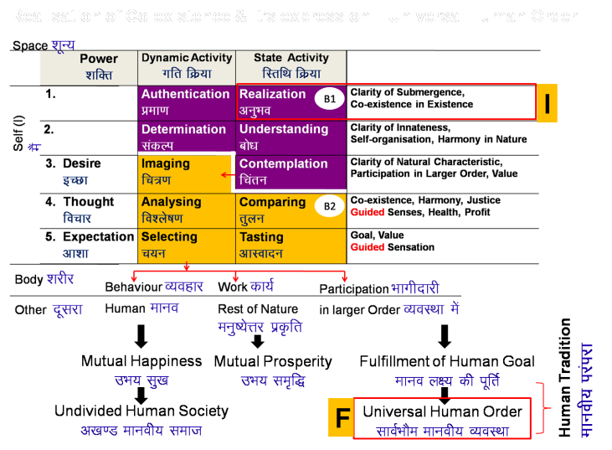
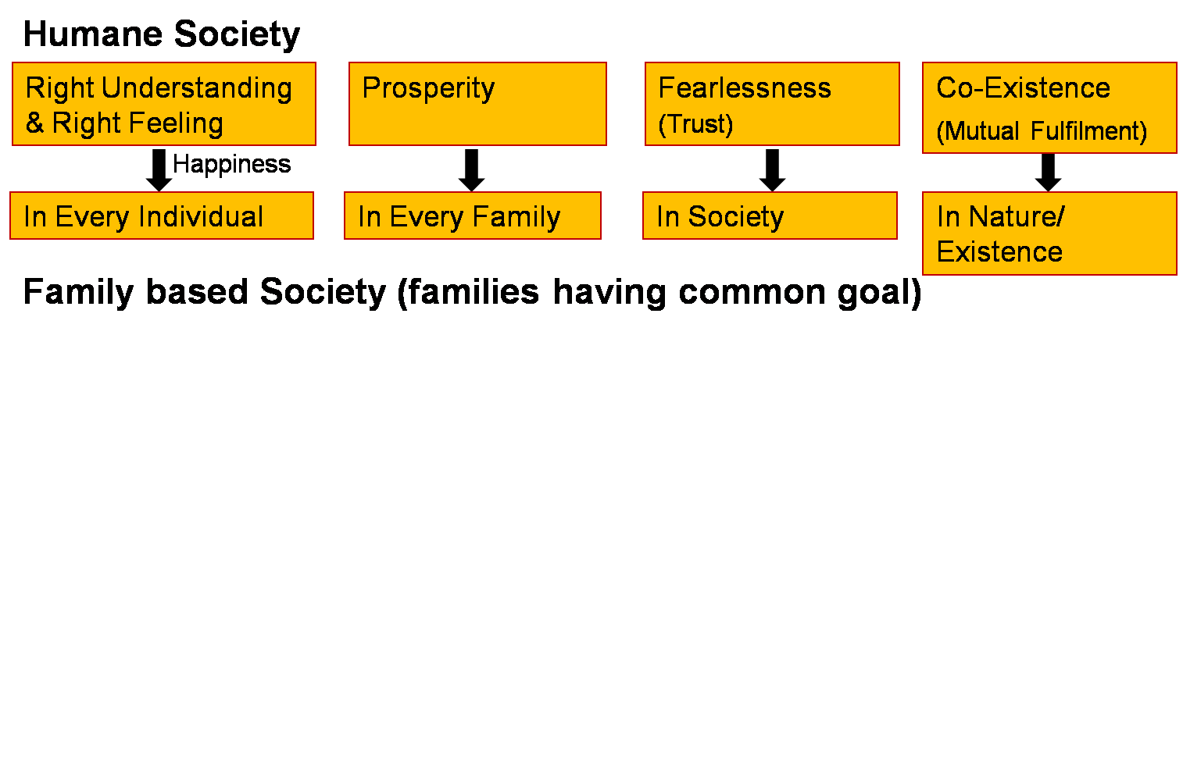
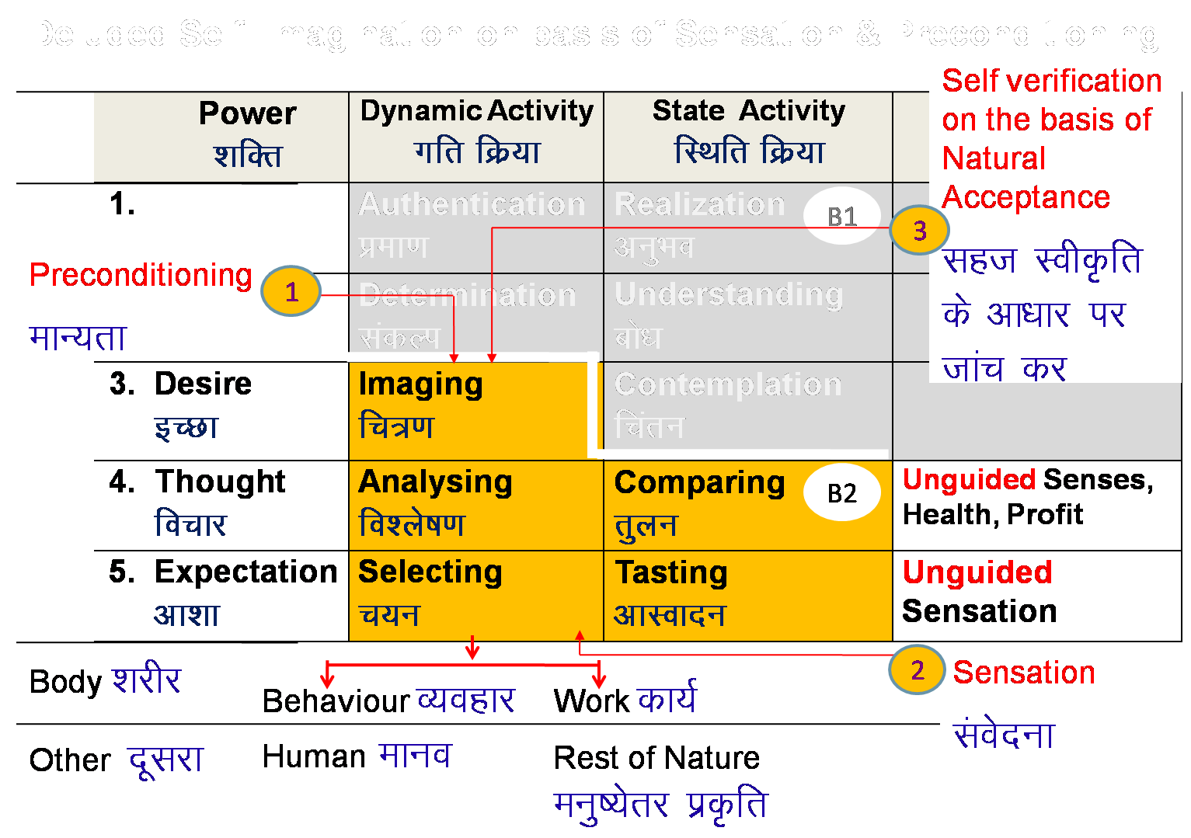
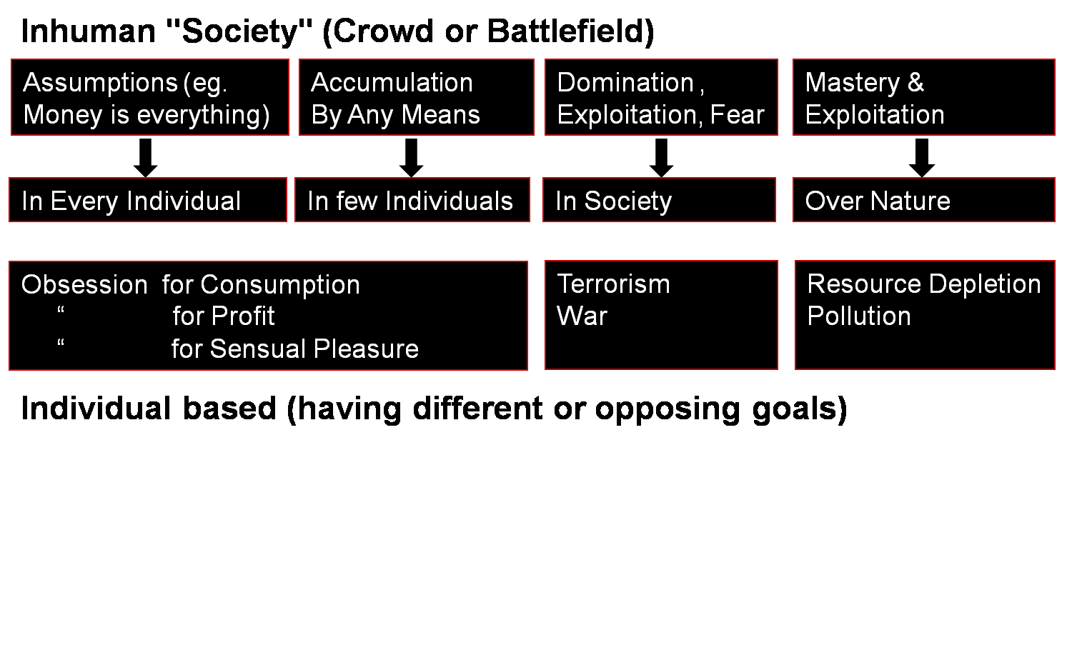
Role of Human Being
Realise the co-existence
Ensure universal human order
REALISATION
WITHIN
Transformation& Progress
laØe.k&fodkl
Societal Transformation
Through
Personal Transformation

Slide 14
Universal Human Order: Dynamics
Human Conduct
Human Education
Human Constitution
Universal Human Order
Human Tradition
Conduct that ensures
continuity of mutual
happiness &
prosperity
Education that
ensures the
development of the
competence to live
with
Definite
Human
Conduct
Nature of
society
of people living
together in a
relationship of
mutual fulfillment
Entry Point
The society in which
Human Goal
is realised

Slide 15
Sum Up lkj la{ksi

Slide 16
Value
Value of a unit is its participation in the larger order
(larger order = larger, harmonious system)
e.g. Value of pen is that it helps to write
(participation in education)
Value of water is that it quenches thirst
(participation in health)
Similarly,
Value of your activities (desire, thought, expectation..) is participation in the harmony within you (in the Self).
Value of your body is participation in your activities as a human being.
Your value in the family is your participation in the harmony in the family.
Your value in the society is your participation in the harmony in the society.
Your value in the nature is your participation in the harmony in the nature.
Your value in the existence is your participation in the co-existence.
So far, we have tried to co-explore the universal values of a human being.

Slide 17
Sum Up
Level. Name | Relationship | Details
4b. Existence | Co-existence | Co-existence Potential for human being to realise
4a. Nature | Mutual Fulfillment 4 orders | Harmony, relationship Potential for human being to be in harmony
3. Society | Right Understanding and Right Feeling, Prosperity, Fearlessness (Trust), Co-existence | Human-Nature relationship Potential, through participation of individuals and families in various societal systems
2. Family | Feeling of Co-existence Trust, Respect … Love | Human-Human relationship Potential for right feeling in the Self – mutual happiness
1b. Individual Human Being | Co-existence of Self and Body | Self-Body relationship Potential for feeling of self-regulation
1a. Self | Continuous Happiness = Happiness, Peace, Satisfaction, Bliss… | Will to live with continuous happiness Potential for right understanding, right feeling and right thought Mutually fulfilling behavior, work and participation…
Universal Human Values

Slide 18
Program of Action

Slide 19
Program of Action (Individual)
To understand harmony and to live in harmony
– at all levels of being (individual, family, society, nature/existence)
Self-exploration – Verify the proposals on your own right → right understanding (of harmony) → feeling and thought of harmony → harmonious behaviour, work and participation in larger order
Self-awareness – Be aware of your desire, thought and expectation – every moment
Self-evaluation – Evaluate your desire, thought and expectation
    – on the basis of your Natural Acceptance
What I Really Want to Be
My Natural Acceptance
My Intention
Discover
Guide
What I am
My Desire, Thought, Expectation…
My Competence
Purify

Slide 20
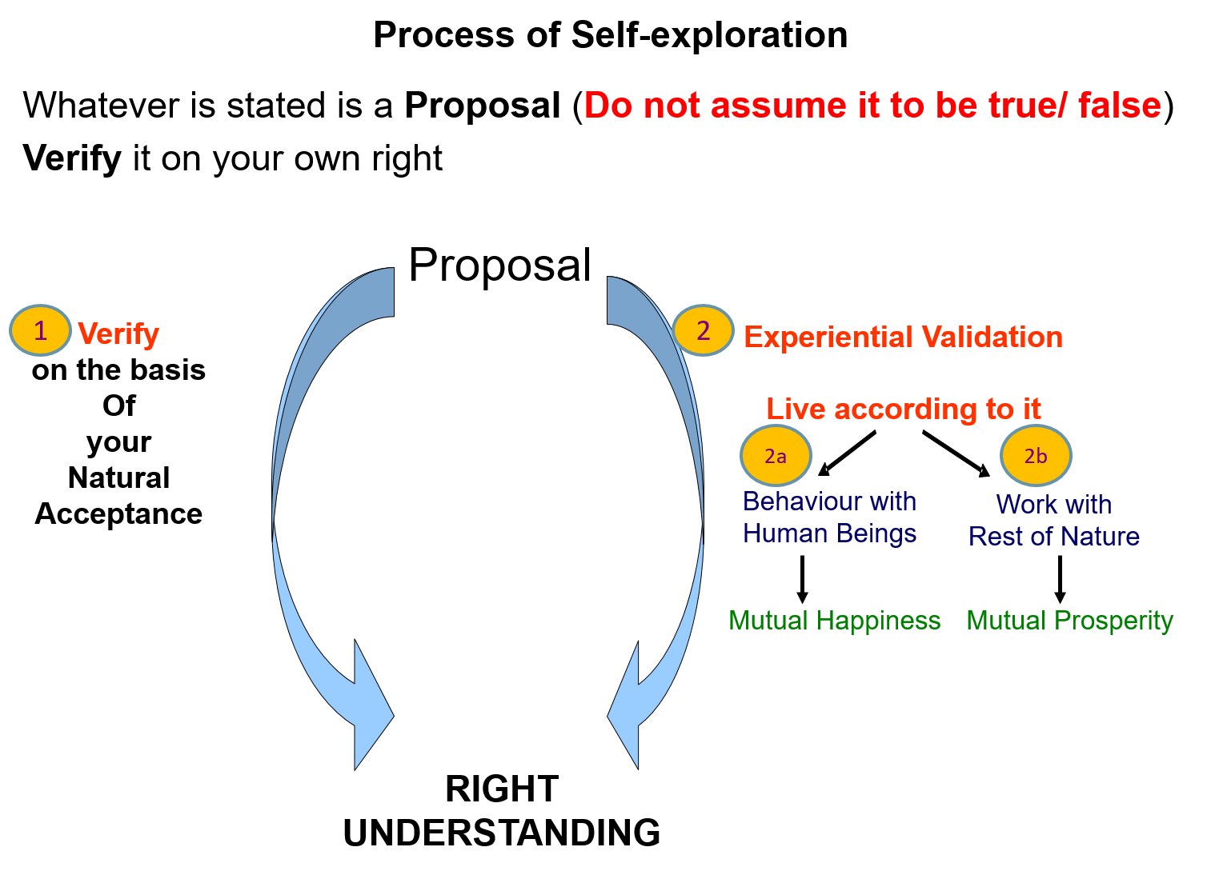
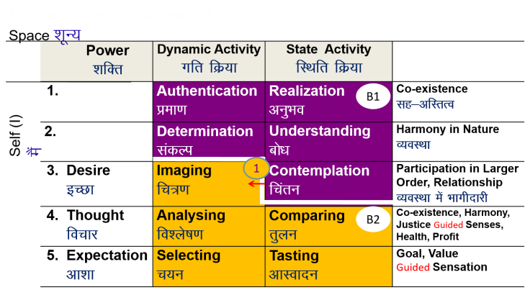
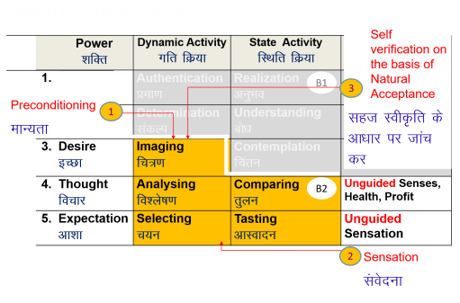
Program of Action (Individual) – 1: Develop Right Understanding
Self-exploration
Verify the proposals
(on your own right)
    Right understanding of harmony at all levels
    Feeling and thought
    of harmony
    Harmonious behaviour, work and participation in larger order

Slide 21
Program of Action (Individual) – 2: Purification of Sanskar
Self-awareness – Be aware of your desire, thought and expectation – every moment
Self-evaluation – Evaluate your desire, thought and expectation
    – on the basis of your Natural Acceptance
Sanskar =
Acceptances derived out of
∑ [Desire + Thought + Expectation]
from all time
+
Acceptances born out of Right Understanding*
* Right Understanding of a reality includes contemplation of its relationship or participation in the larger order, understanding of the harmony and realisation of co-existence in existence of that particular reality.
Sanskar (t+1) = Sanskar (t) + Environment (t) + Self-exploration (t)

Slide 22

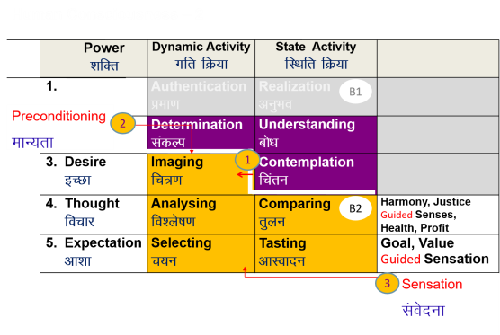
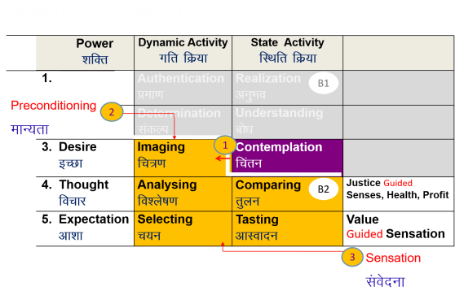

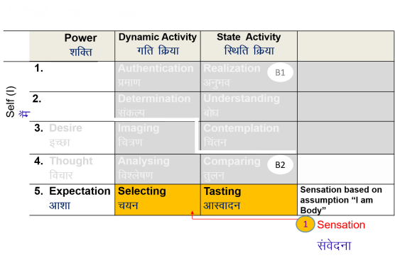
Self-evolution
Self-exploration
Self-verification
Human Consciousness
Living on the basis of knowing
Happiness by being in harmony within and harmony in all aspects of being
Acceptance of relationship – from one to many, to all [HAPPINESS]
Identifying need, production, right utilisation of physical facility [PROSPERITY]
Participation in larger order, expanding harmony [SOCIETAL DEVELOPMENT]
Transformation / Development
Living on the basis of assuming (without knowing)
Happiness from outside (through feeling from the other, sensual pleasure and physical facility)
Domination and opposition in relationship [UNHAPPINESS]
Exploitation and indulgence [DEPRIVATION]
Exploitation in larger order, increasing disorder [DEGRADING SOCIETY]
Animal Consciousness

Slide 23
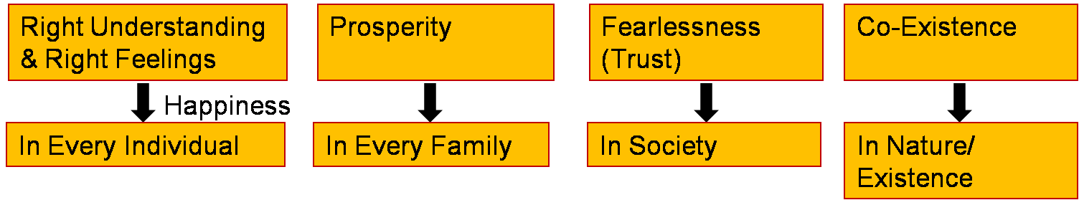
Program of Action (at the level of Society)
People’s Education Program : for adults
Education-Sanskar Program : for children
Undivided Society, Universal Human Order Program
Just as a seed replicates itself, so the vision of an Undivided Society and Universal Human Order can be evidenced on this planet…
Family – Family cluster – Village – Village cluster ... Nation ... World Family
10 yrs 1
Next 10 yrs 10
100 yrs 1000 cr
People with Right Understanding & Right Feelings
Parents - Policy Makers
Teachers …
Course in Academic Curriculum
Socially Relevant Projects
Conducive Environment
20-50 yrs
People with Right Understanding & Right Feelings
- People with definite Human conduct, the competence to participate in Universal Human Order
Fulfilment of Human Goal
10-20 yrs

Slide 24
Self Reflection

Slide 25
Key Points
Lecture 22: The Holistic Perception of Harmony in Existence

Slide 26
FAQs for Lecture 22
The Holistic Perception of Harmony in Existence

Slide 27
Question(s): Response
How do we go about ensuring right understanding? Is Meditation helpful in this? What is Meditation?
Let us first try to understand what meditation is, and then we can see how it may be useful in ensuring right understanding:

Slide 28
FAQ: Meditation (Paying Attentiion): To See The Reality As It Is
Paying attention (focus on some reality) Process of paying attention
To see the reality as it is (5 aspects of reality) Purpose of paying attention
- Form, property can be seen by the self through the body
- To see the other 3 aspects viz. natural characteristic, innateness, co-existence you have to look within & every self has the potential to see these directly
Realisation of Co-existence
Feeling of Love Outcome of paying attention
Expression of Love, i.e. Living with Compassion
If the purpose of meditation is clear & the object of attention is within (B1), it can lead to awakening to contemplation, understanding and eventually realisation
If the object of attention is outside or it is B2, it does not yield any significant results, however elaborate the process of meditation may be. One continues to live at the level of B2

Slide 29
FAQ: Meditation: To See The Reality As It Is
Example: 4 steps in Vipassana Meditation
Kaya Focus on body
Vedana " sensation
Sanskar " sanskar (B2)
Dhamma " underlying laws (Co-existence)
Example: Ashtang Yoga
Yam laws of how we relate to the external world
Niyam laws of how we relate to ourselves, the inner world
Asan balancing of the body parts and organs
Pranayam balancing of breathing, the life force energies
Pratyahara paying attention to one's self, Withdrawal of senses from their external objects
Dharana paying attention to (Concentration of the Chitta upon) a object, a reality
Dhyan continuity of paying attention- Meditation
Samadhi direct observation of the reality- Oneness with the object of meditation (Co-existence)

Slide 30
FAQ: Meditation: To See The Reality As It Is
Paying attention is primary or object of attention is primary?
For example, a thief knows how to concentrate. He does pay attention to something he considers valuable
You are also concentrating on what you consider valuable. For example
  If money is important for you, you keep track of your bank balance
  If relationship is important for you, you keep track of trust
It is the object of focus that is significant and not just the method of concentration. If you can realise that you are significant, then you will pay attention to your Self(I)
  You will become aware of what is going on in your desire, thought & expectation
  You will become aware of your natural acceptance (so whenevery you decide, it will be on the basis of your natural acceptance)
So essentially we are talking about meditation every moment. Living with awareness, of reality as it is, every moment

Slide 31
Question(s): Response
They say “live in the present”… is that the way to right understanding?

Slide 32
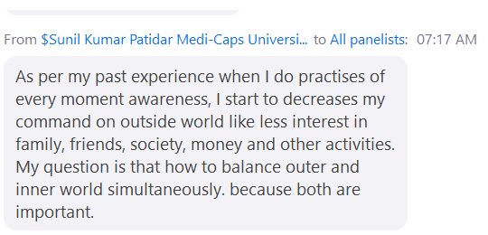

Slide 33
Living in the Present Living in the Ever Present
Regret of Past
Fear of Future
Opposition for Present
Evaluating Past on the basis of co-existence (no regret)
Planning Future on the basis of co-existence (fearlessness)
Living Now on the basis of co-existence (mutual fulfillment with units)
We tend to recall past when the present is not engrossing and
- some happy event (to draw happiness) or
- there is some regret
We tend to think of the future when the present is not engrossing and
- we want to plan for the future course of action or
- when there is an apprehension / uncertainty about the future
We tend to to be engrossed in the present when
- we are in harmony within and
- making effort for harmony outside
We are not engrossed in the present when
- we are in dis-harmony within

Slide 35
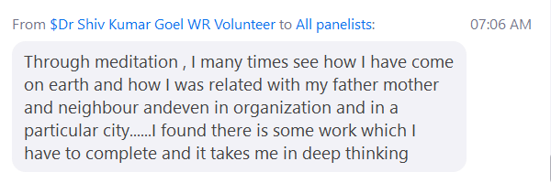

Slide 36
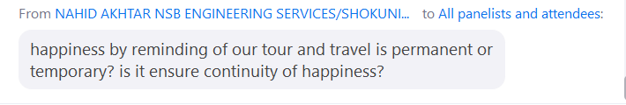

Slide 37
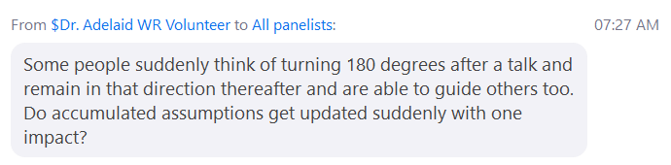

Slide 38
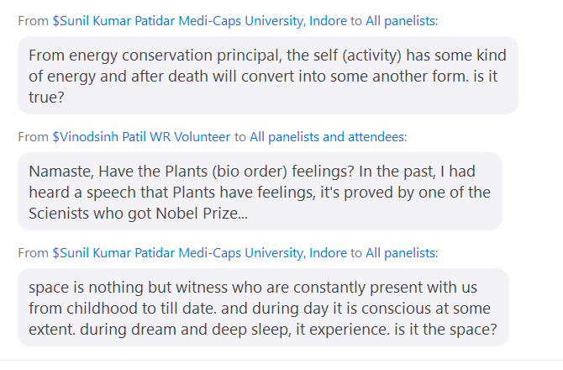

Slide 39
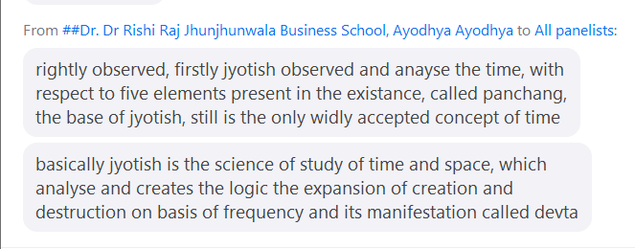

Slide 40
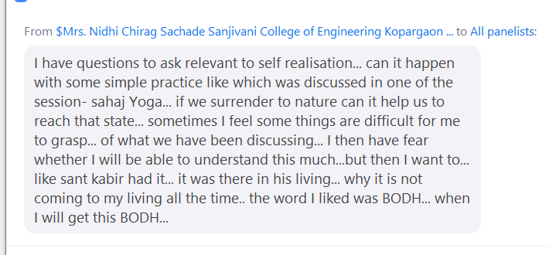

Slide 41
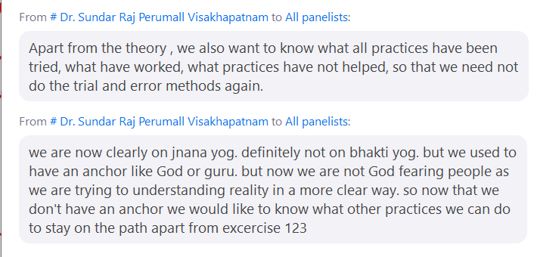

Slide 42
Copy Drawings from Here
C:\Users\Rajul Asthana\Documents\Zoom\2021-02-17 06.13.14 Refresher Workshop for Resource Persons & Potential RP on Universal Human Values 85232103346

